Slide 1
MY Bank Banking Application
Team : Asset Avengers
Module :Loan Application

Slide 2
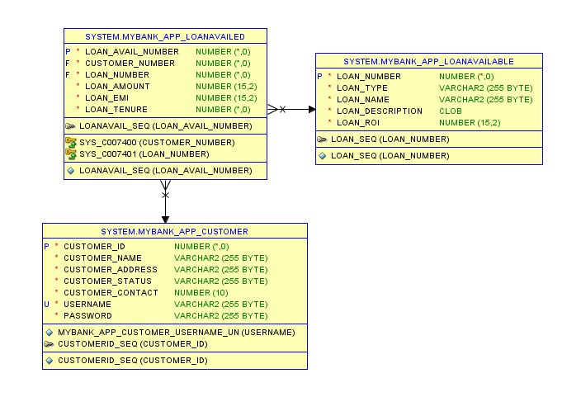
Database Design

Slide 3
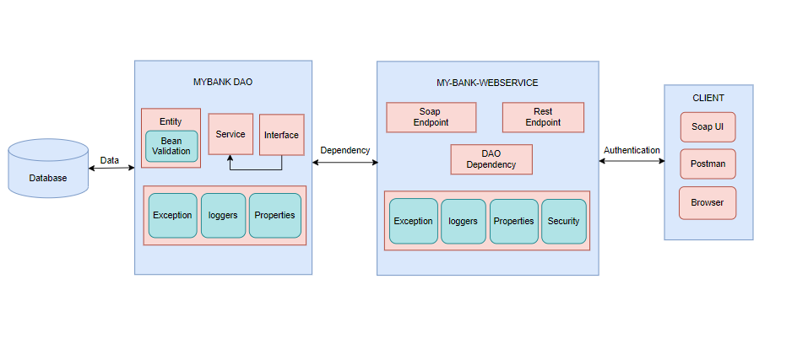
Project Structure

Slide 4
Data Flow Diagram
SEARCH BY LOAN TYPE
YES
DISPLAY
BY
LOAN TYPE
START
DISPLAY LOANS
YES
LOAN
AVAILABLE
NO
LOANS
THROW EXCEPTION
STOP
THROW EXCEPTION
STOP
NO

Slide 5
Links and Files
GitHub link: https://github.com/shreya-poojari/DLTE-JAVAFULLSTACK-SHREYAMPOOJARY-2024/tree/bccf65477547a2ab94be9da21c76672c7a6152e4/DLTE-Project

